Slide 1
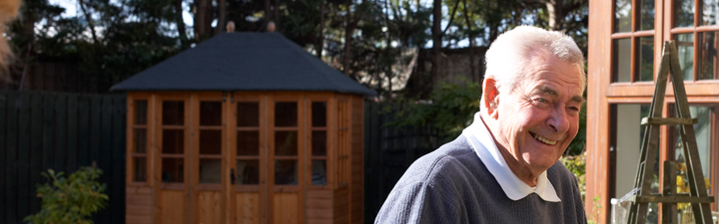
South West Hospital Standards in Dementia Care
South West Dementia Partnership
Living well with dementia across the South West

Slide 2

Living with dementia
Video ‘The Patels - In their own words (Part 4/4)’ www.youtube.com/watch?v=nl9xqm_9KbE courtesy of the Alzheimer’s Society YouTube channel www.youtube.com/user/AlzheimersSociety

Slide 3
National audit
95% of hospitals do not have mandatory training in dementia awareness for staff
1/3rd of patients did not have a nutritional assessment recorded during their admission
< 50% of patients received a formal mental status test upon admission to hospital
1/3rd of patients referred to in-hospital psychiatry liaison services had not been seen after 96 hours

Slide 4
Regional standards
Developed by the South West Expert Reference Group, led by Alison Moon, regional champion for dementia care in hospitals
To complement the national audit
To support providers and commissioners to assure high quality care
To enable patients, their relatives or carers to call the service to account

Slide 5

8. Appropriate training and workforce development
2. Agreed assessment, admission and discharge processes with a needs specific
care plan
5. Nutrition and hydration needs are well met
1. Respect, dignity and appropriate care
7. Ensure quality of care at the end of life
3. Access to a specialist older people’s mental health liaison service
6. Promote the contribution of volunteers
4. A dementia friendly hospital environment; minimising moves

Slide 6
1. Respect, dignity and appropriate care
Person-centred care, care planning and risk assessment
Dementia ward champion
Accessible literature and training materials
Regular reviews
Notes:
A Ward Champion for dementia is appointed to provide leadership for delivery and monitoring (where applicable), as well as training
There is accessible literature on the ward for patients, carers and staff
The care plan is person-centred for each patient
There is individualised and appropriate risk assessment
Patient care is person centred, informed by Dementia Care Mapping or similar methodology.
The trust Board regularly reviews serious and untoward incidents, falls, delayed discharges, and complaints associated with patients with dementia

Slide 7
2. Agreed assessment, admission and discharge processes with a needs specific care plan
Carers information and needs assessment
Use of ‘This is me’ booklet
Comprehensive assessment
Memory service referrals
Actively managed discharge
Access to intermediate care
Notes:
The lead carer is identified and provided with information about how they can support the patient
A booklet ‘This is me ‘about each patient is completed to inform care plans
All patients with suspected dementia receive a comprehensive assessment with further referral to memory service if required
Carers receive information about the assessment
Carers understand that an assessment of their needs can be arranged
There is a system so that all staff are aware of the patients with dementia
Discharge is actively managed from 24 hours of admission
Information on discharge / support available on admission
There is a named person who takes responsibility for discharge coordination
Discharge plans summarise assessment and treatment and support plan
There is access to intermediate care

Slide 8
3. Access to a specialist mental health liaison service
Multi disciplinary,specialist mental health liasion- level of service based on assessed need
Appropriate referrals for further assessment
Liaison team training incorporated into local training strategies
Notes:
There is access to a full multi disciplinary, specialist mental health liaison service. The level of service is based on assessed need
Appropriate referrals are made for further assessment
Training provided by liaison teams is incorporated into local training strategies

Slide 9
4. A dementia-friendly environment, minimising moves
Appropriate signage / sensory environments
Environment quality reviews
Minimise moves
‘This is me’ booklet to accompany the patient
Daily therapeutic and recreational activities
Notes:
The hospital Clinical Champion determines appropriate signage and sensory environments across the hospital and reviews quality of environment during peak activity so that standards do not slip
Patients with dementia should not be moved between wards (or hospital) unless required for their care and treatment
If a move is necessary it should be at least disruptive time and carers informed and involved if appropriate
‘This is me’ profile must accompany the patient is moved
Daily therapeutic and recreational activities are available where appropriate

Slide 10
5. Nutrition and hydration needs are well met
Weight assessments / malnutrition screening
Patient preferences in ‘This is me’ booklet
Protected mealtimes with carers or volunteers
Flexible food times, appropriate utensil provision
Specialist assessment for swallowing difficulties
Notes:
All patients have a weight assessment and are assessed via malnutrition screening
Patient preferences are recorded in ‘This is me’
Protected mealtimes with carers or volunteers actively encouraged to assist
Flexibility in provision and timing of food and appropriate utensils / crockery
Access to specialist assessment in 12 hours if swallowing difficulties

Slide 11
6. Promote the contribution of volunteers
Designated volunteering leads
Dementia ward champion role
Volunteer support, feedback and training
Review volunteer recruitment and retention
Notes:
There is designated leader within hospital to promote volunteering for people with dementia
The Ward Champion identifies ways to improve patient experience by greater involvement of volunteers
Support, feedback and training provided to volunteers
Regular review of recruitment and retention of volunteers

Slide 12
7. Quality of care at the end of life
GPs informed
Integrated care pathway
Training for clinical and support staff
Notes:
GPs are informed of patients identified as approaching end of life
Patients who remain in hospital to die are cared for using an integrated care pathway
All clinical and support staff receive appropriate training

Slide 13
8. Appropriate training and workforce development
New staff receive mandatory training
Training and knowledge framework
Implementation with regular review
Notes:
All new staff receive mandatory training
The hospital has a training and knowledge framework in place which is being implemented and reviewed

Slide 14
Relevant, aligned and locally owned
Locally relevant
Aligned with expectations
Locally driven and accountable
Involvement and ownership
Notes:
Locally relevant
Include as a commissioning requirement for contracts for general and community hospitals in 2011-2012
Inform the delivery of QIPP plans
Provide a basis for discussion about CQUIN payments between commissioners and their providers
Inform Trust Quality Accounts
Reflected in published Local Action Plans to demonstrate delivery of the National Dementia Strategy
Aligned with expectations
Liberating the NHS: Transparency in the outcomes - a framework for the NHS
Care Quality Commission (CQC) core quality and safety standards with key aspects of good dementia care;
National Institute for Health and Clinical Excellence (NICE) Quality statements
National Audit of Dementia Care in Hospitals, which is underway in 2010/11
South West Strategic Framework for Improving Health 2008/09 to 20010/11
South West Strategic Health Authority 2010 Performance Assessment Framework for delivery of the National Dementia Strategy
Locally driven and accountable
Some standards directly within the control of ward staff
Others may require additional resources
Clear measures / indicators to inform implementation monitoring
Connected to local governance structures
Involvement and ownership
Dementia ward champion role recommended
Alzheimer’s Society and other local groups
Greater engagement of patients, family, carers, friends and a range of volunteers is fundamental

Slide 15
Promoting the standards
Regional promotion
A suite of materials for local adoption www.southwestdementiapartnership.org.uk/hospital-standards/
Clinical and ward champions
Training and education opportunities
Notes:
These standards have been produced in a variety of formats for patients, their family, carer or friends understand them and can hold services to account.
The standards are presented in a format that will assist staff delivering care on wards as well as assisting commissioner / provider discussions.
There will be widespread distribution of information about the standards to cover all interested groups and organisations in the South West.
Clinical and Ward Champions will be required to use every opportunity to aid the understanding of these standards, and ensure that training and education programmes delivered within hospital trusts promote delivery.

Slide 16
Delivery timeline
31 Jan 2011 brief relevant leads and groups
31 March 2011 hospital self-assessment
30 June 2011 improvement plan for 2011/12
Sept-Dec. 2011 peer review
31 March 2012 improvement plan for 2012/13

Slide 17
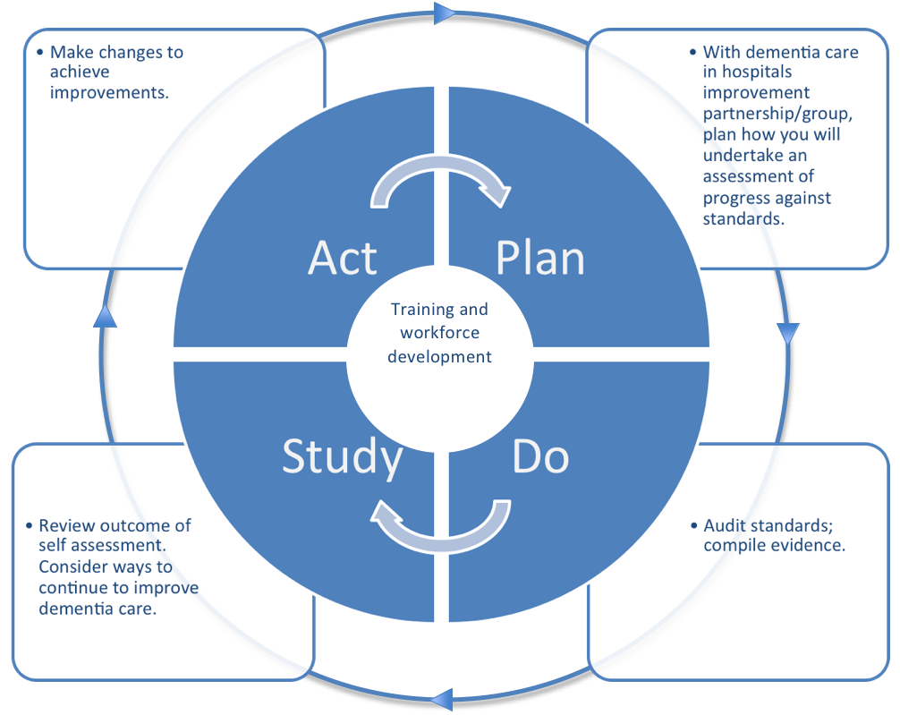
Continuous improvement

Slide 18
Find out more
www.southwestdementiapartnership.org.uk/hospital-standards/
Notes:
These standards have been produced in a variety of formats for patients, their family, carer or friends understand them and can hold services to account.
The standards are presented in a format that will assist staff delivering care on wards as well as assisting commissioner / provider discussions.
There will be widespread distribution of information about the standards to cover all interested groups and organisations in the South West.
Clinical and Ward Champions will be required to use every opportunity to aid the understanding of these standards, and ensure that training and education programmes delivered within hospital trusts promote delivery.

